Slide 2
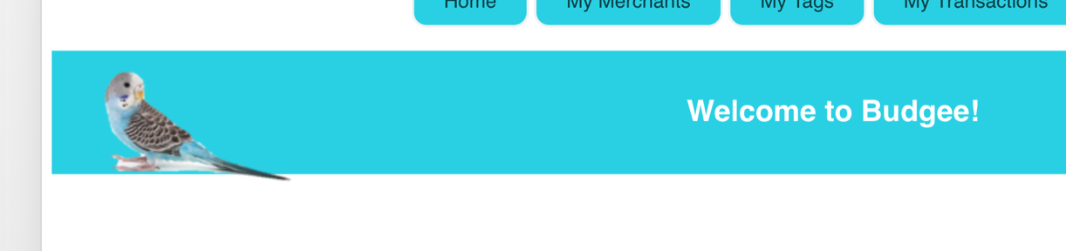

<<system>>
Budgee budgeting app program
Add transactions
Choose merchants and tags
Check money left in budget
Compare transactions

Slide 3
Sainsburys Shop: Transaction
@id:1 @amount:50 @merchant_id:1 @tag_id:1 @essential:”Yes” @time_added:2018-09-29
May 2018: Budget
@id:1 @budget_name: “May 2018” @budget_amount:500 @start_time:2018-05-01 @end_time:2018-05-30
Sainsburys: Merchant
@id:1 @merchant_name:Sainsburys
Groceries: Tag
@id:1 @tag_name:Groceries
Sainsburys Shop deduced from May 2018 budget: Budget_transaction
@id:1 @transaction_id:1 @budget_id:1

Slide 4
Constraint Category | Implementation Constraint | Solution
Hardware and Software Platforms
Performance Requirements
Persistent storage and transactions
Usability
Budgets
Time

Slide 5
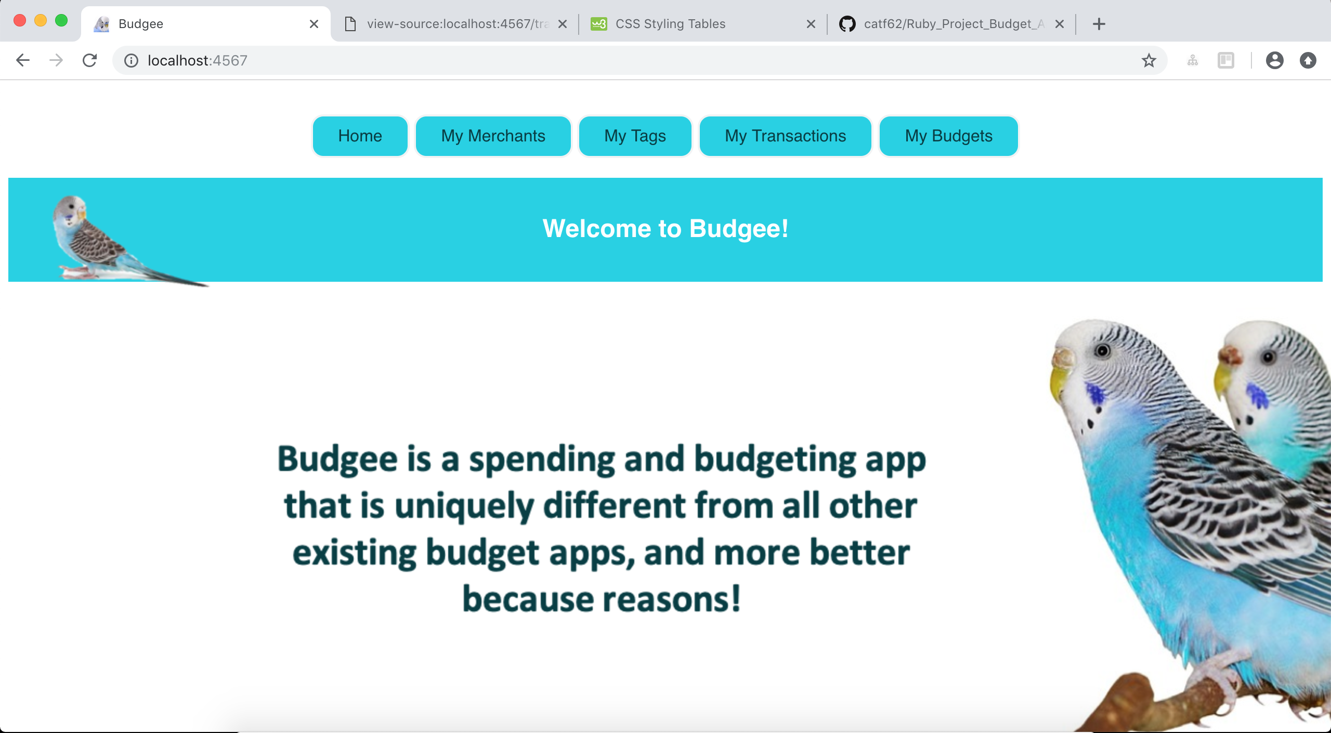
CodeClan Weeks 4 and 5
Ruby Project – Budgee App

